Slide 1
Paul’s
BLAST Instance
Hiro’s CHARMM
Instance
Paul’s
BLAST
Data
BLAST
Service
CHARMM
Service
Hiro’s CHARMM
Data
BLAST
BINARY
HPC Cluster
CHARMM
Binary
Management Node
Compute Node
Index Server
Query Server
Query Server
Query Server
Operating System
Patches
Cluster Software
Server
Boot Device
Installation Media
one (of several) possible DAGs for HPC. This is one of potentially several different renderings.

Slide 2
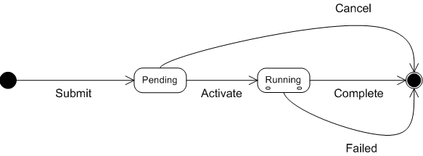
HPC Profile State Transition UML
HPC State Transition In UML - UML representation of the diagram in the BES v1.0 doc

Slide 3
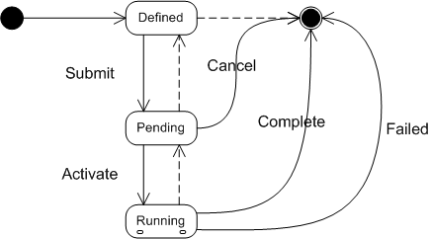
HPC Profile State Transition UML 2
HPC State Transition 2 In UML - UML pulling this together with EGA Ref Model showing an implied state (Defined) and implied transitions.

